Slide 1
Materials Sector’s spending on R&D in year 1 vs year 2

Slide 2
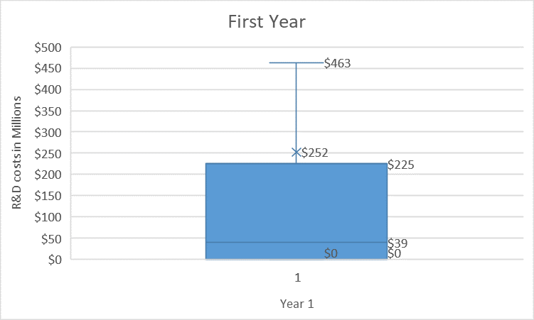
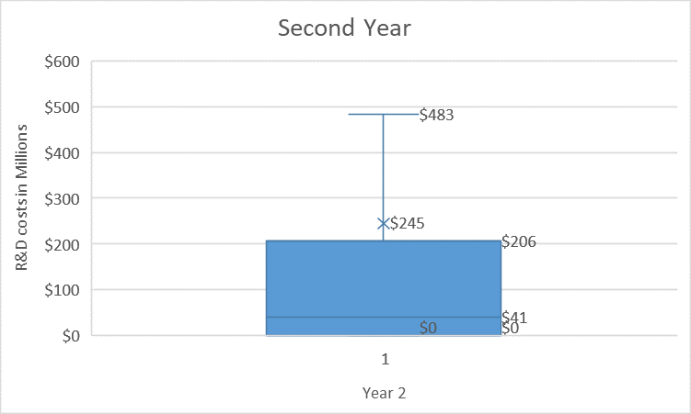
Comparison
The two diagrams on the left of this page depicts the costs of R&D for the first and second year in the Materials sector across all companies. The mean in second year is less than the first year, by 3 millions. The median in year 1 was $39 million while in year 3, it was $41 million.
Hence, the Material companies are not increasing their spending on R&D.

